Slide 1


Biostats and Big Data 2
Lecture 01
Lecture 01
Class overview
CHOONG-WAN WOO | COCOAN lab | http://cocoanlab.github.io

Slide 2

Lecture 01
Introduction
Lab webpage
https://cocoanlab.github.io/
CHOONG-WAN WOO | COCOAN lab | http://cocoanlab.github.io

Slide 3
Lecture 01
Course overview
Biostats and Big data… and this is the Biostats and Big data II
Class code: GBE 3072
Room: Computer room (86103) at N-center 1st floor
“Biostats and Big data” focuses on the “conceptual” aspects of basic statistics
“Biostats and Big data II” will focus more on the “hands-on” aspects of basic statistics
We will learn basic statistics frequently used in research papers
We will learn how to read the results, how to run the analyses, and how to report the results
3R: Read, Run, and Report – this is the learning goal of this course
CHOONG-WAN WOO | COCOAN lab | http://cocoanlab.github.io

Slide 4
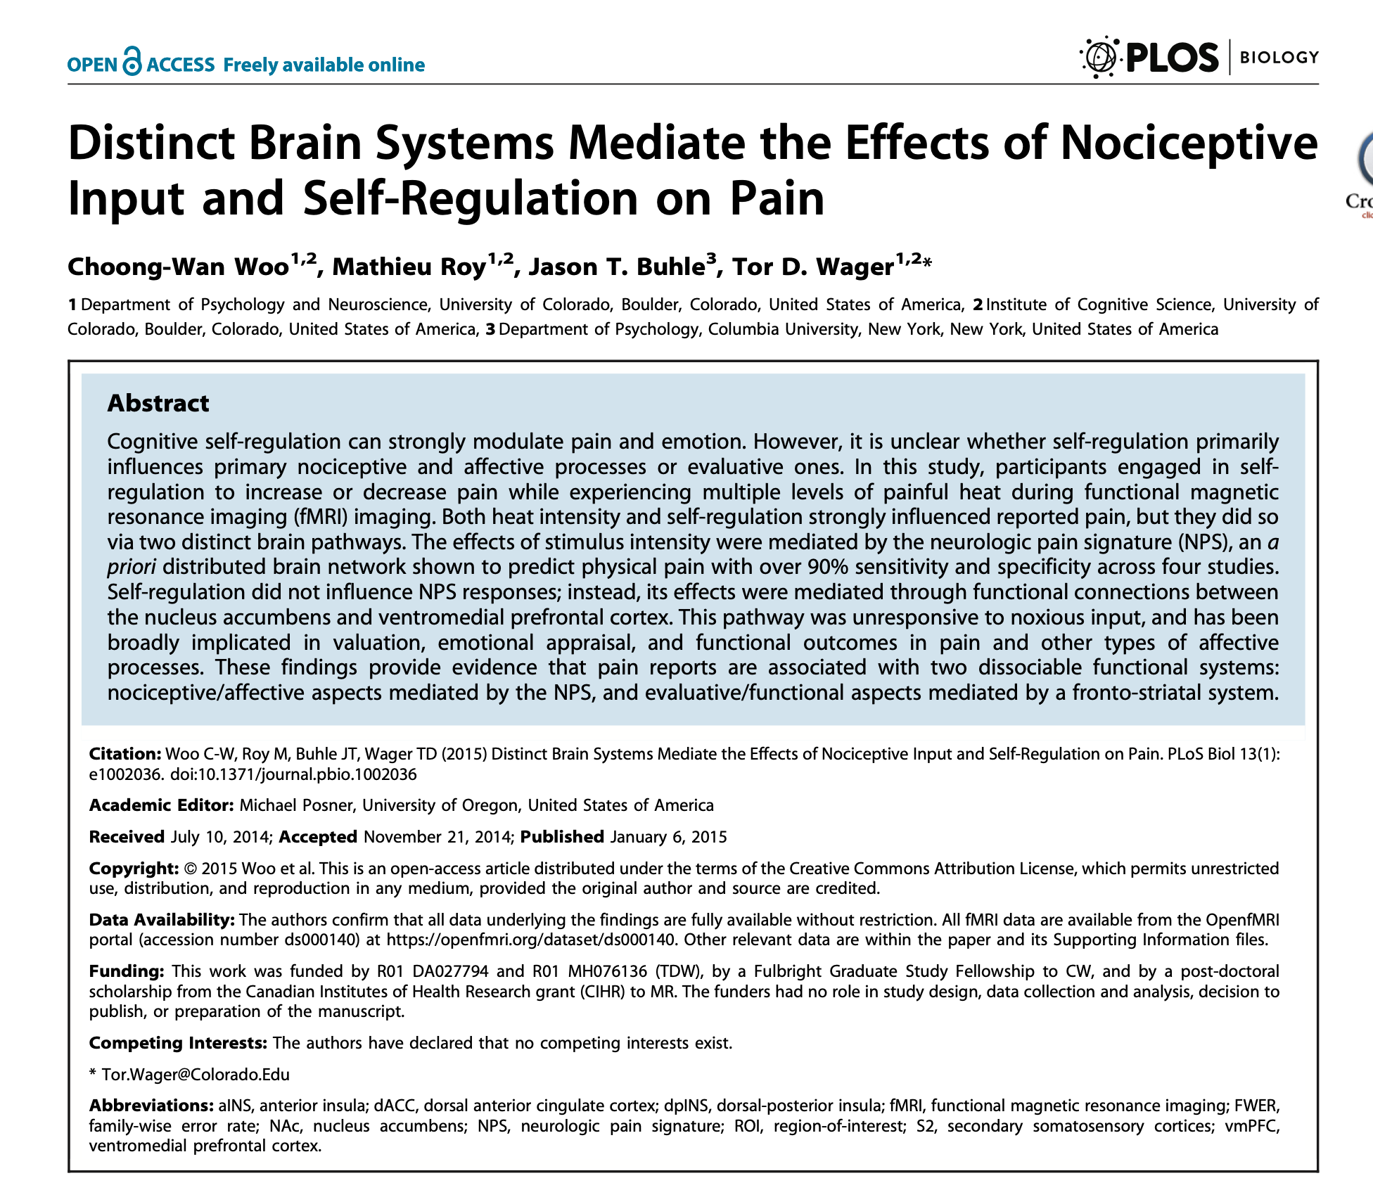
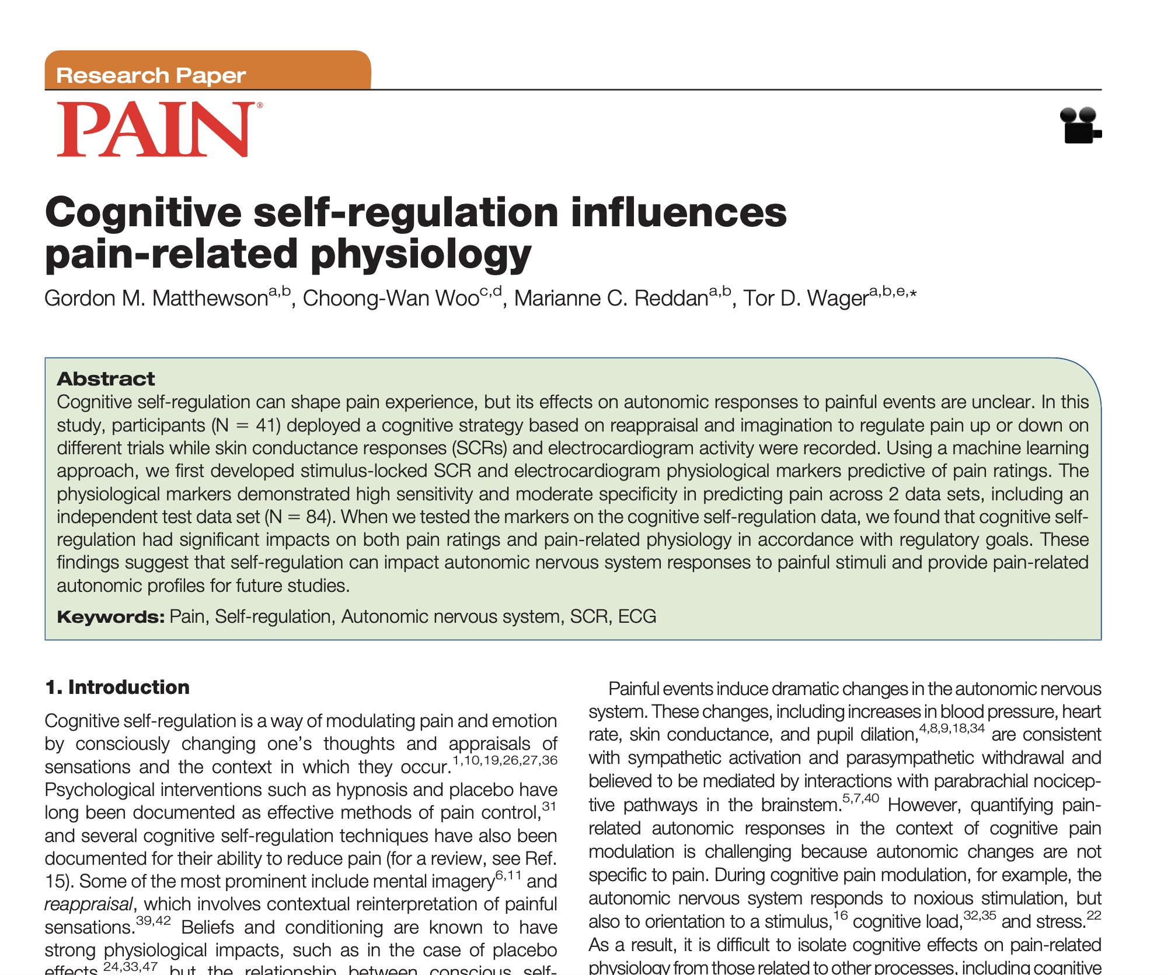
Lecture 01
3R: Read, Run, Report
We will start with these two papers!
Similar tasks, paradigms... I will explain the details of the papers next week, but let’s take a brief look!
CHOONG-WAN WOO | COCOAN lab | http://cocoanlab.github.io

Slide 5
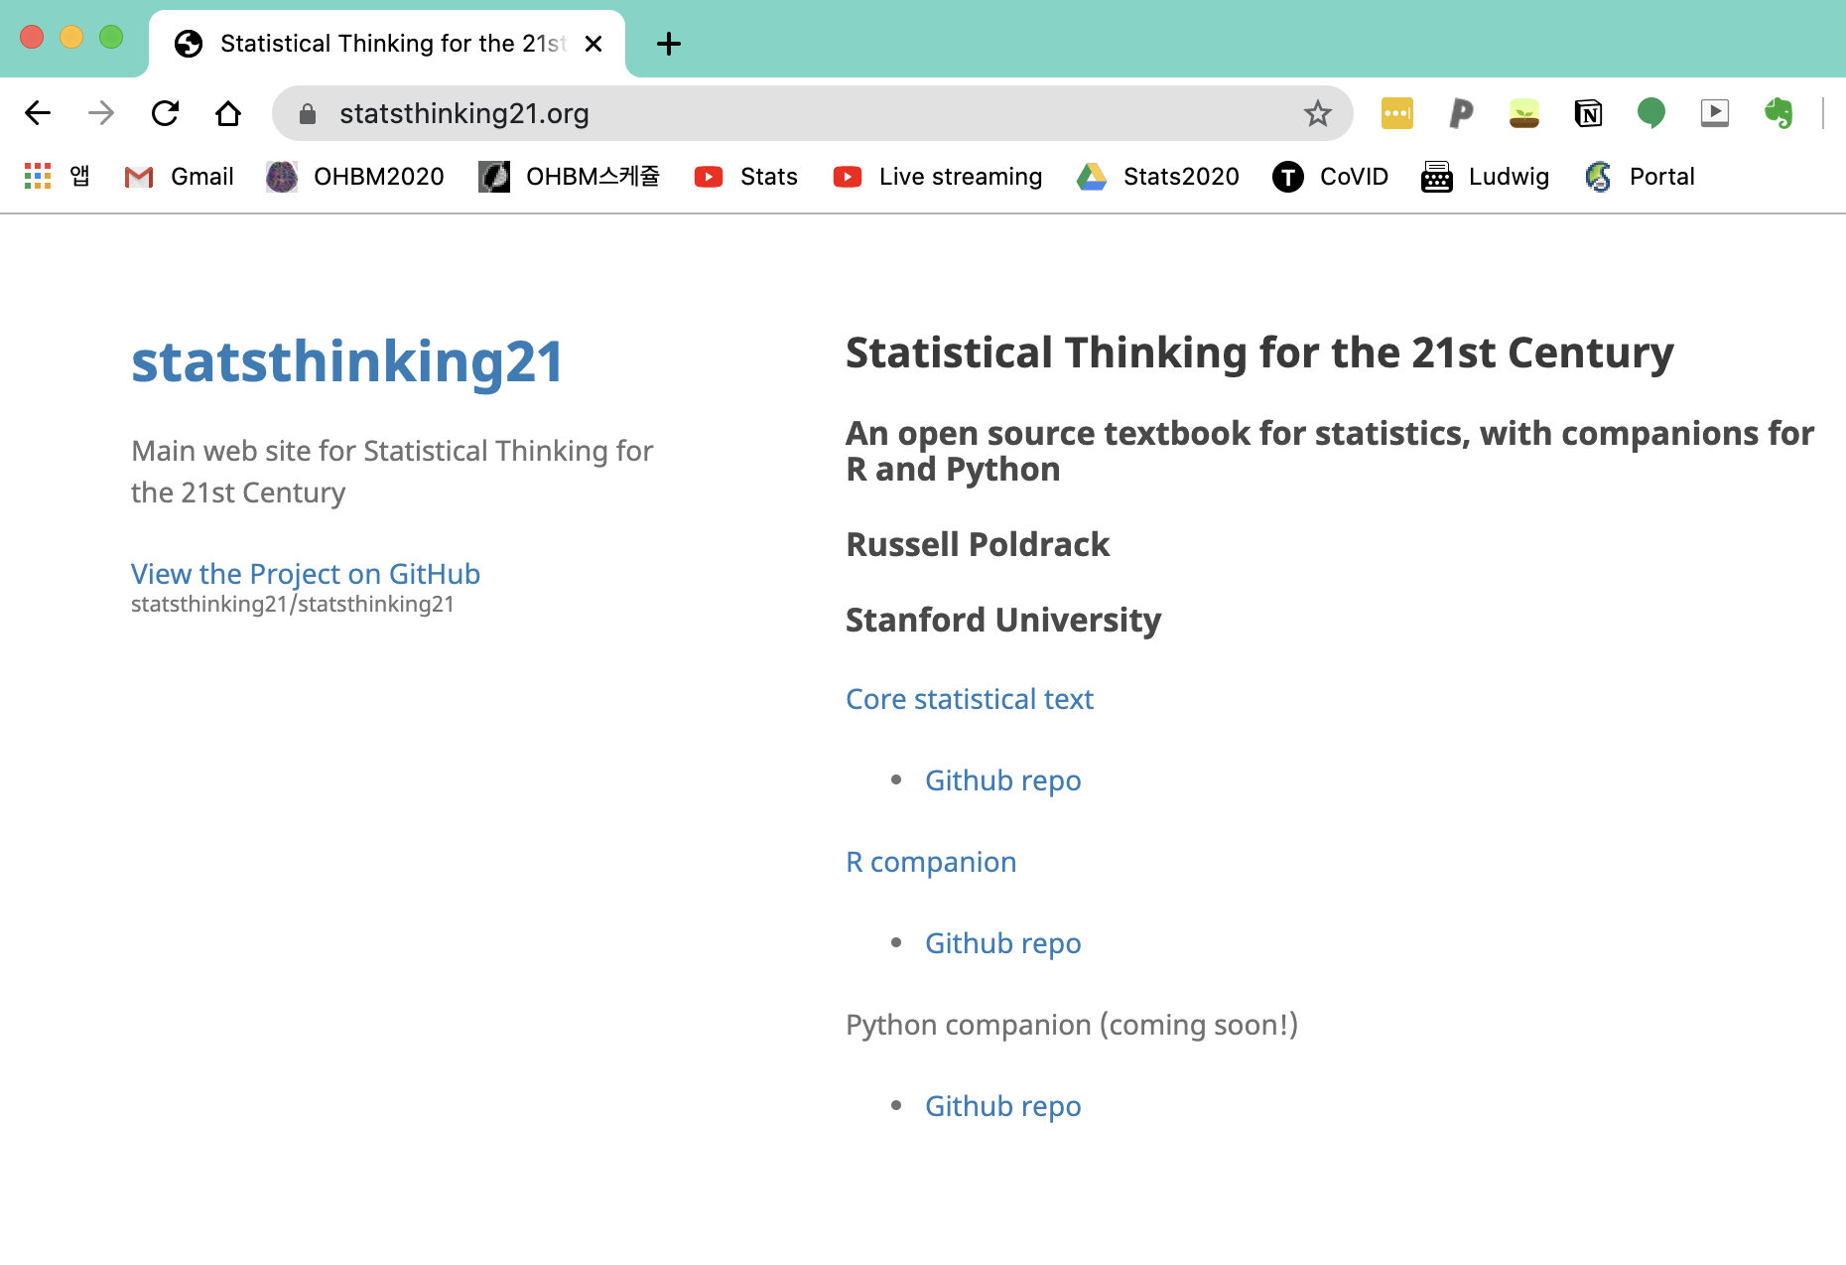
Lecture 01
Textbooks
Textbook: we will keep using the stats textbook of the “Biostats and Big data” class
"Stats: Data and Models" by De Veaux, Velleman, and Bock, Fourth Edition
But we will also use “Statistical Thinking for the 21st Century” by Russell Poldrack
This is the online book (free!!)
You can also download PDF or EPUB
CHOONG-WAN WOO | COCOAN lab | http://cocoanlab.github.io

Slide 6
Lecture 01
Web-based platforms for the class
We will use two useful web-based platforms for the class:
Slack for class-related discussion and questions
https://join.slack.com/t/wanistats2fall2022/shared_invite/zt-1f1m6tbx3-2~wp6NZRhd780GU09vD6fg
2. GitHub for posting class-related materials, assignments, data, codes, etc
CHOONG-WAN WOO | COCOAN lab | http://cocoanlab.github.io

Slide 7
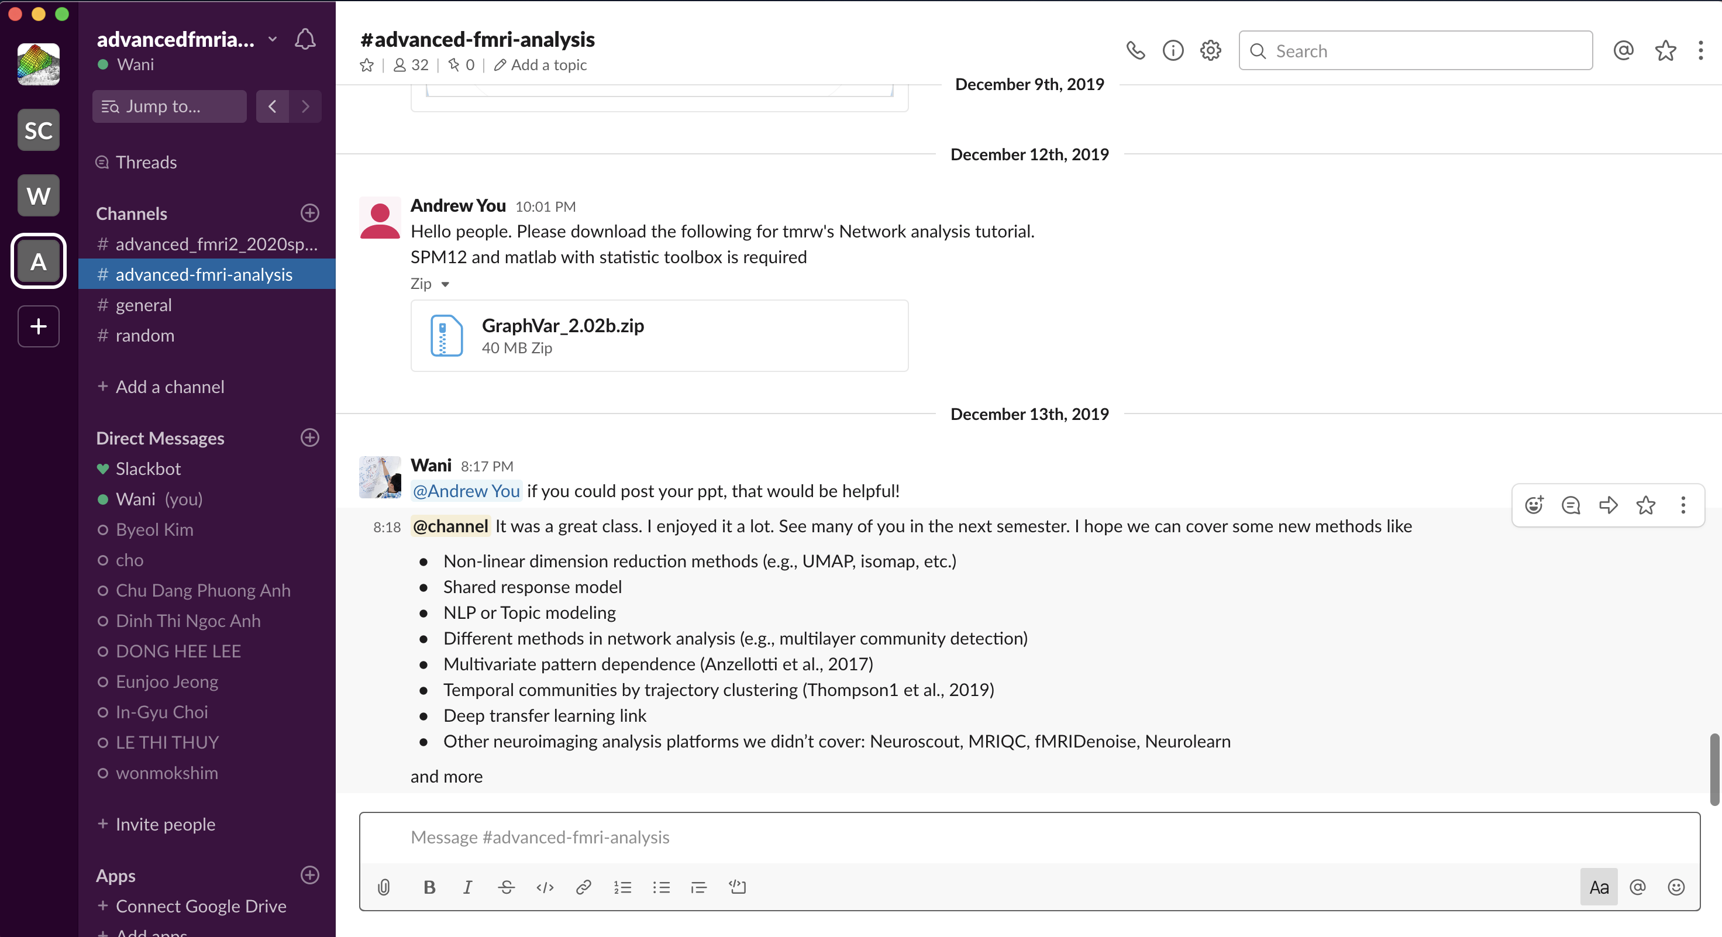
Lecture 01
A great platform for team communications
You can sign up for the class through this link: https://join.slack.com/t/wanistats2fall2022/shared_invite/zt-1f1m6tbx3-2~wp6NZRhd780GU09vD6fg
Works for both desktop and mobile phone
Real examples
CHOONG-WAN WOO | COCOAN lab | http://cocoanlab.github.io

Slide 8
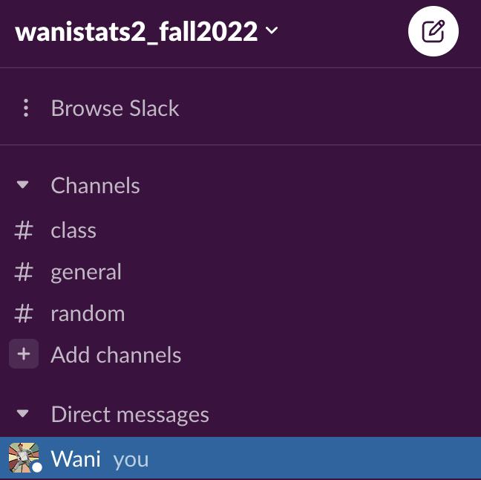
Lecture 01
Please use 이름_학번! (e.g., 우충완_123456789)
CHOONG-WAN WOO | COCOAN lab | http://cocoanlab.github.io

Slide 9
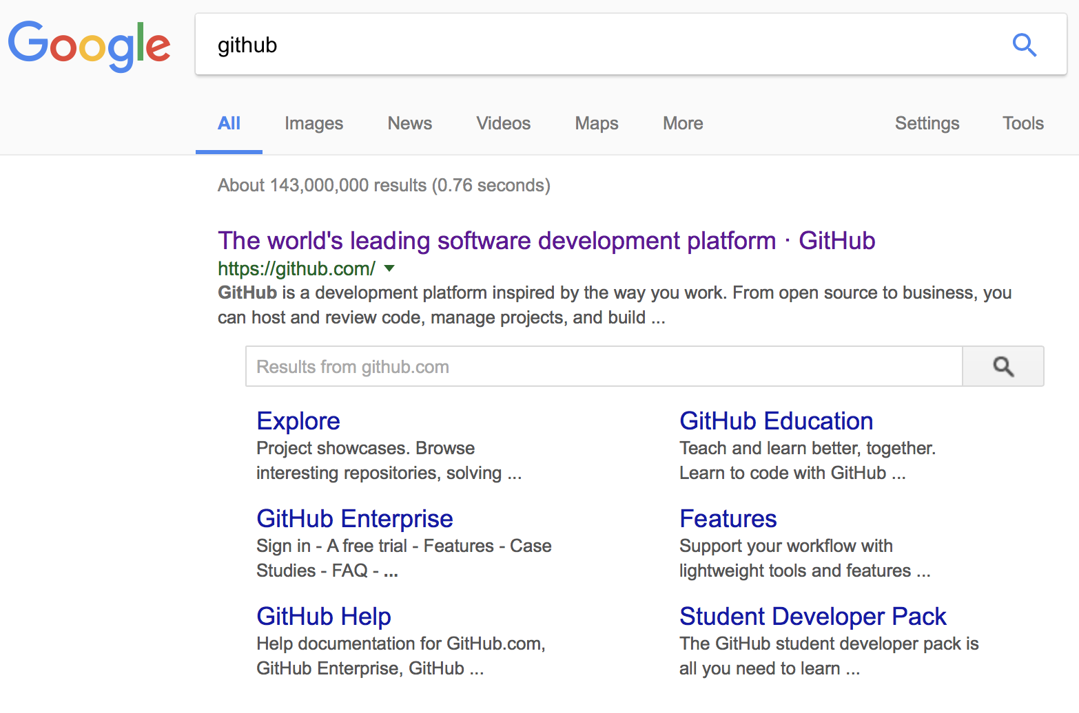
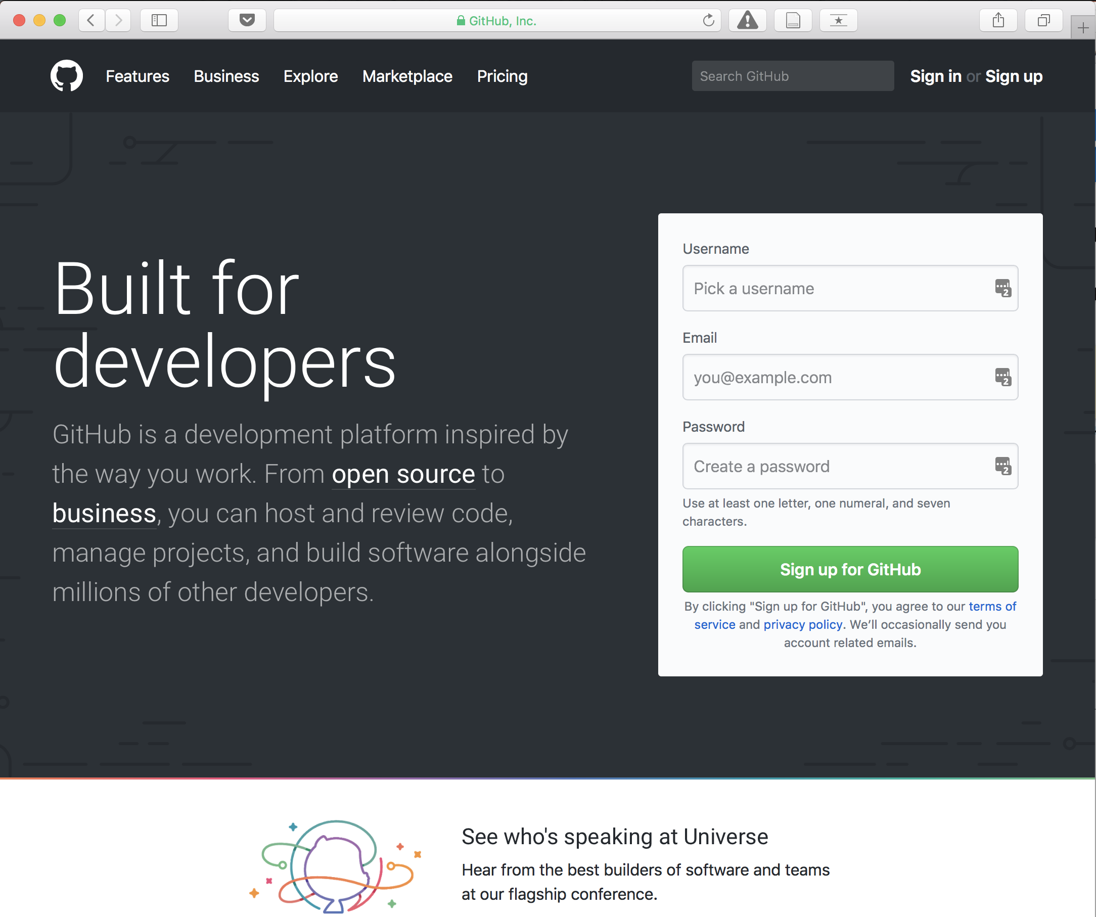
Lecture 01
Most popular software development platform: version control, easy-sharing scripts and data, etc.
CHOONG-WAN WOO | COCOAN lab | http://cocoanlab.github.io

Slide 10
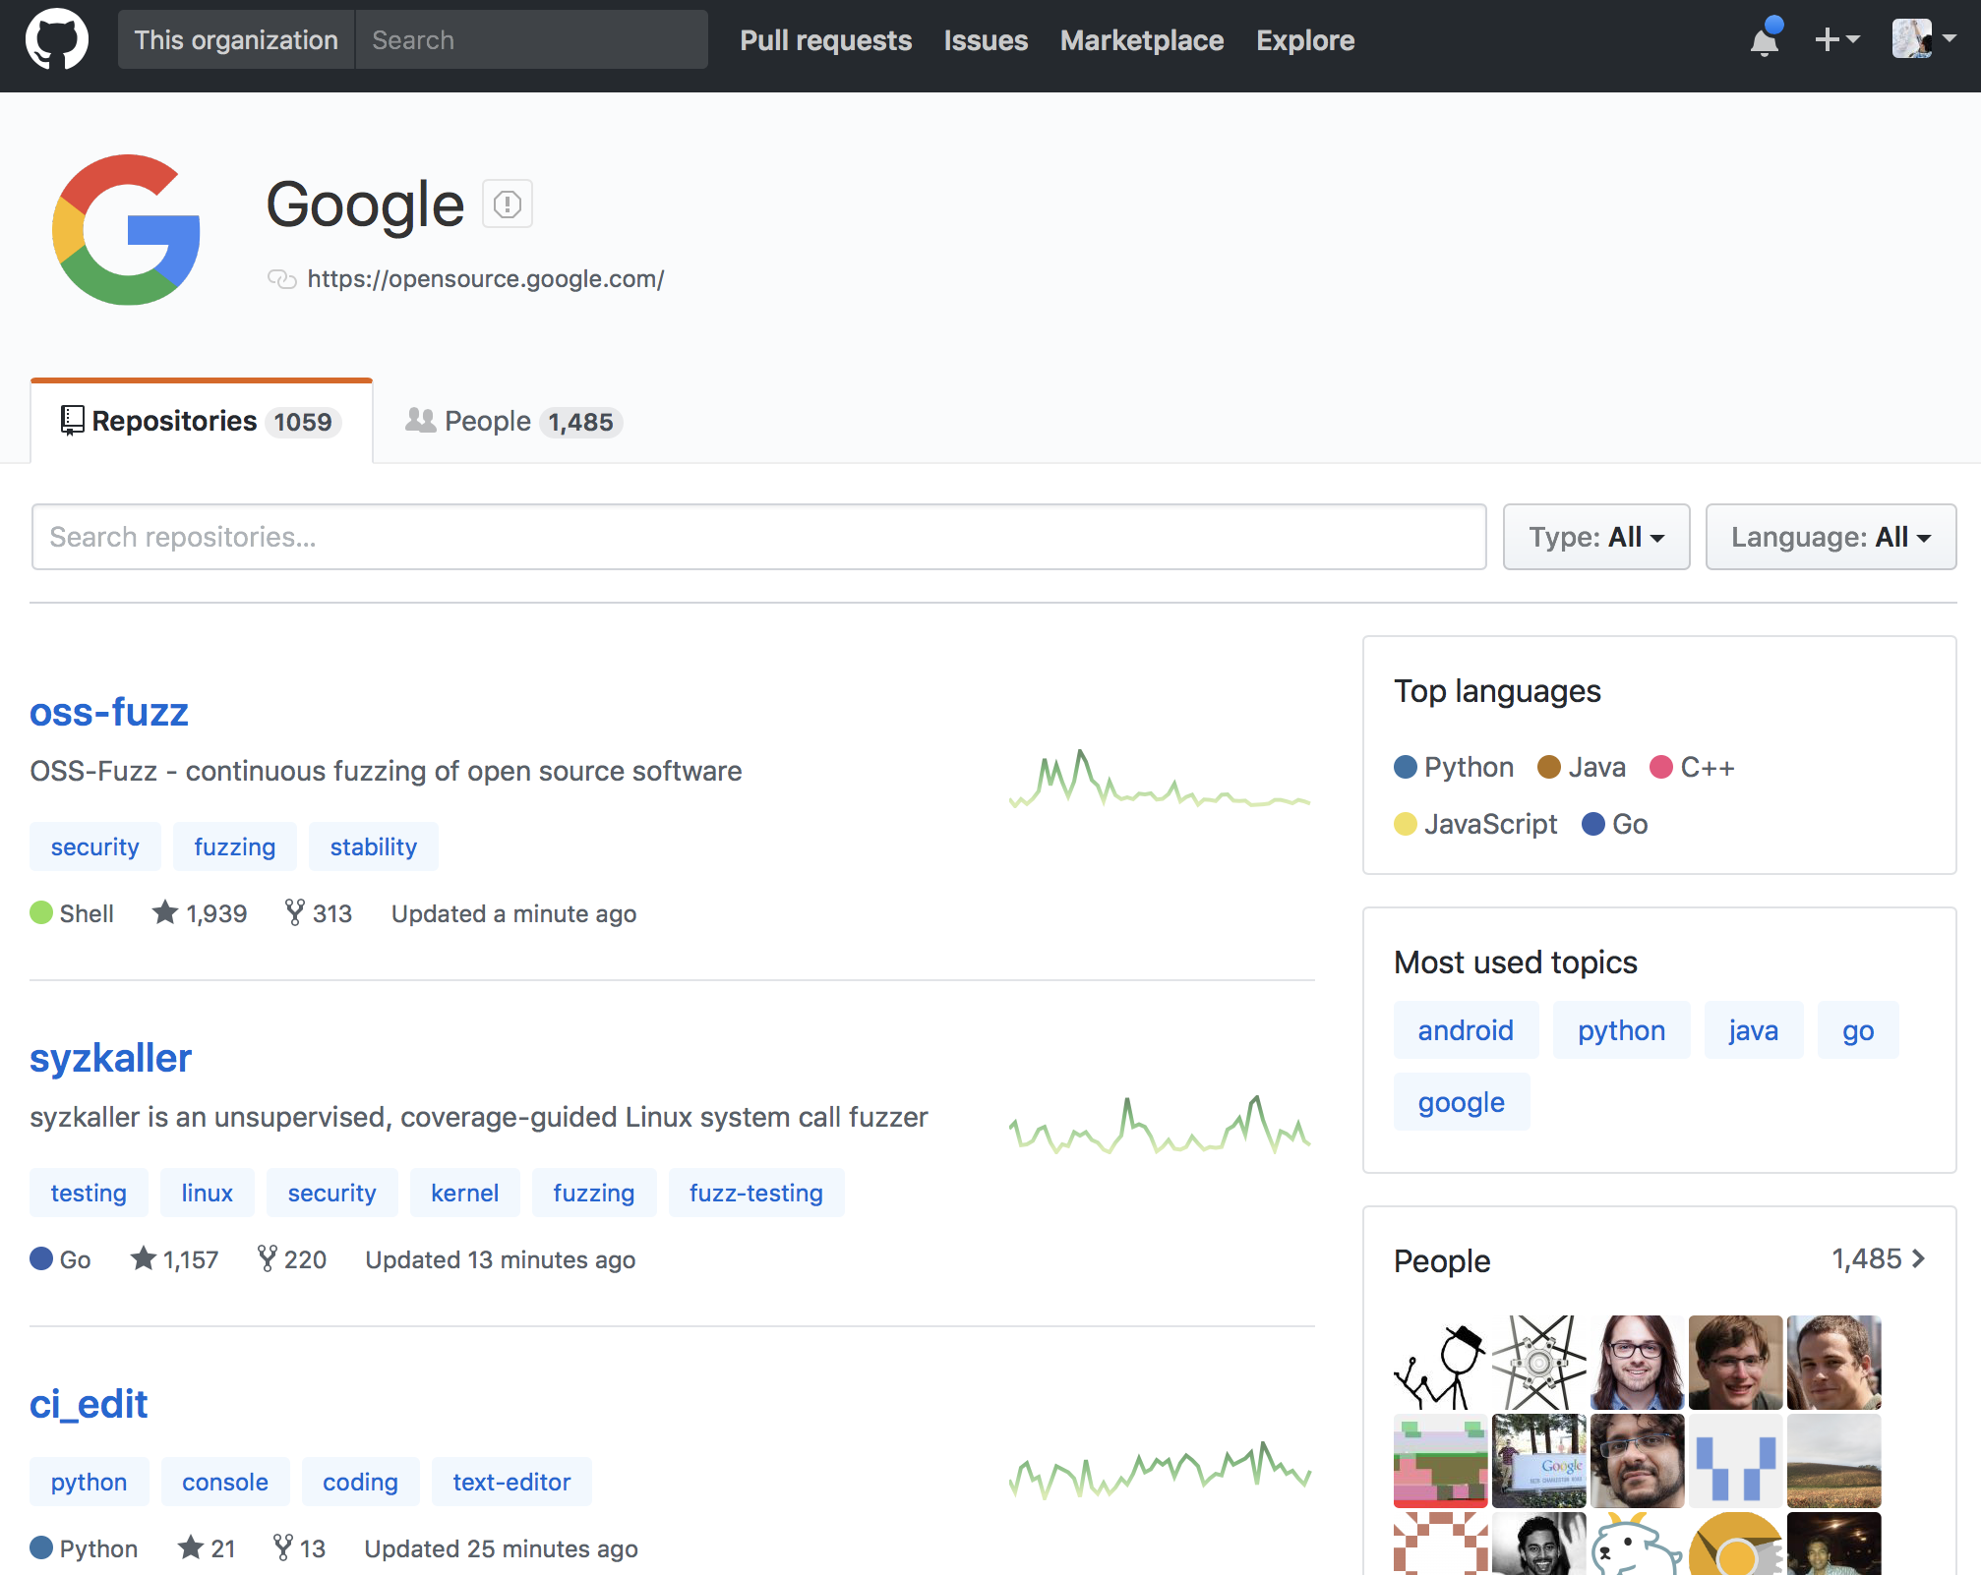
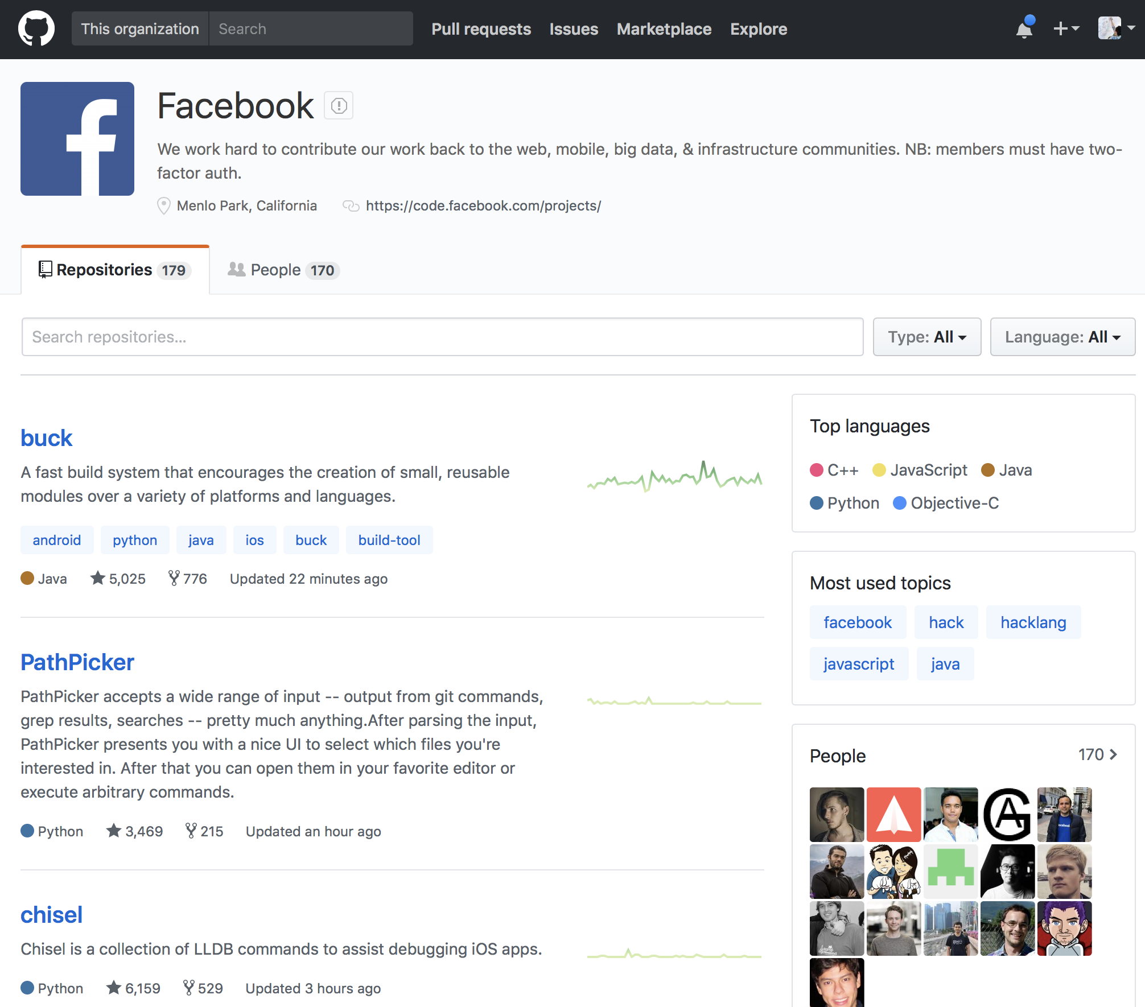
Lecture 01
Most popular software development platform: version control, easy-sharing scripts and data, etc.
Everyone uses GitHub for the development, including Google, Facebook, etc.
CHOONG-WAN WOO | COCOAN lab | http://cocoanlab.github.io

Slide 11
Lecture 01
Most popular software development platform: version control, easy-sharing scripts and data, etc.
Everyone uses GitHub for the development, including Google, Facebook, etc.
More and more people are creating and sharing a GitHub repository for their research and publications:
CHOONG-WAN WOO | COCOAN lab | http://cocoanlab.github.io

Slide 12
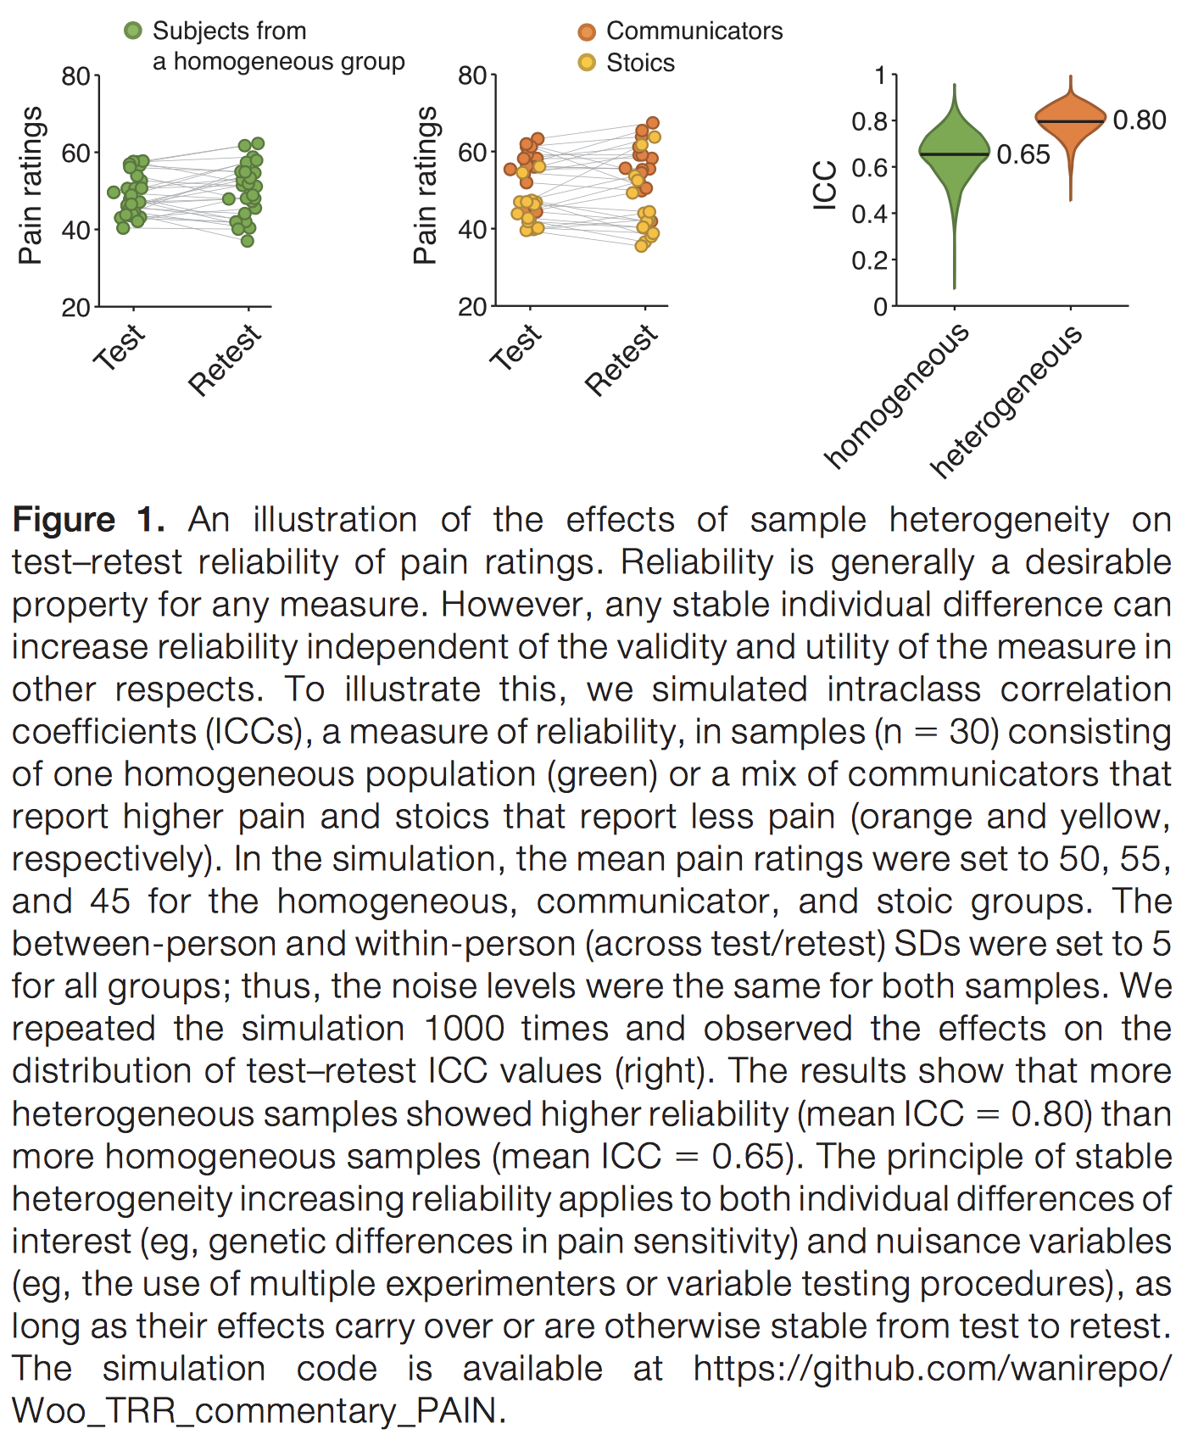
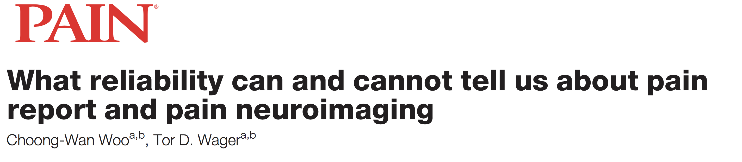
Lecture 01
Most popular software development platform: version control, easy-sharing scripts and data, etc.
Everyone uses GitHub for the development, including Google, Facebook, etc.
More and more people are creating and sharing a GitHub repository for their research and publications:
E.g., Woo & Wager, 2016, PAIN
CHOONG-WAN WOO | COCOAN lab | http://cocoanlab.github.io

Slide 13
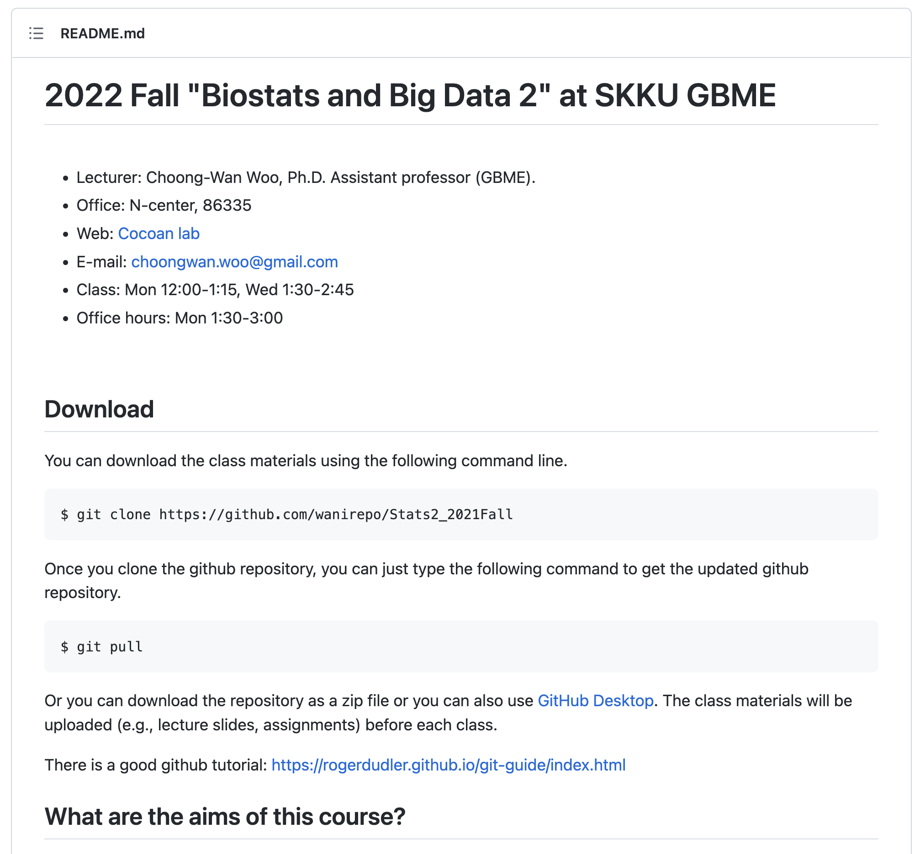
Lecture 01
Our class website: https://github.com/wanirepo/Stats2_2022Fall
README.md is the syllabus.
Let’s visit the website and read the syllabus together.
CHOONG-WAN WOO | COCOAN lab | http://cocoanlab.github.io

Slide 14
Lecture 01
Lastly,
Jamovi cloud vs. Jamovi local
CHOONG-WAN WOO | COCOAN lab | http://cocoanlab.github.io

Slide 15
Lecture 01
To-do
Sign up for slack
https://join.slack.com/t/wanistats2fall2022/shared_invite/zt-1f1m6tbx3-2~wp6NZRhd780GU09vD6fg
Watch the “Softwares and programming languages” video
CHOONG-WAN WOO | COCOAN lab | http://cocoanlab.github.io

